Slide 1



Prédictions Coupe du Monde de football 2022
Lounis Guidjou
PREDICTIONS
Lounis Guidjou

Slide 2

Agenda
Context.
Source Data.
Data Exploration.
Teams To Follow.
Results.
Conclusion.

Slide 3
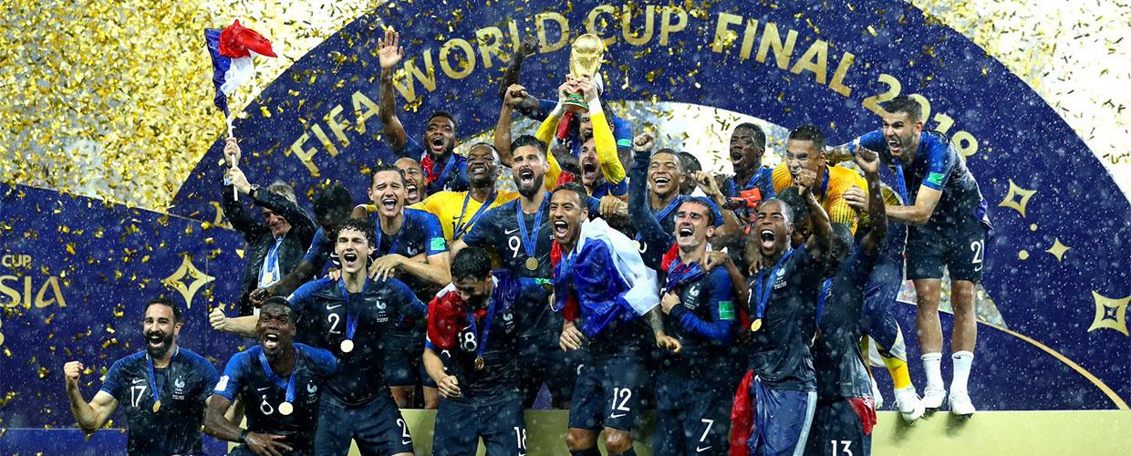
Context.
Determine which team will win 2022 World Cup
The goal of this project is to help me find the winner of the next world cup and make the right bets.
Which team will succeed France?

Slide 4
First tests.
Tries during last World Cup Playoffs.
5 Games
4 Good Bets
1 Bad Bet

Slide 5
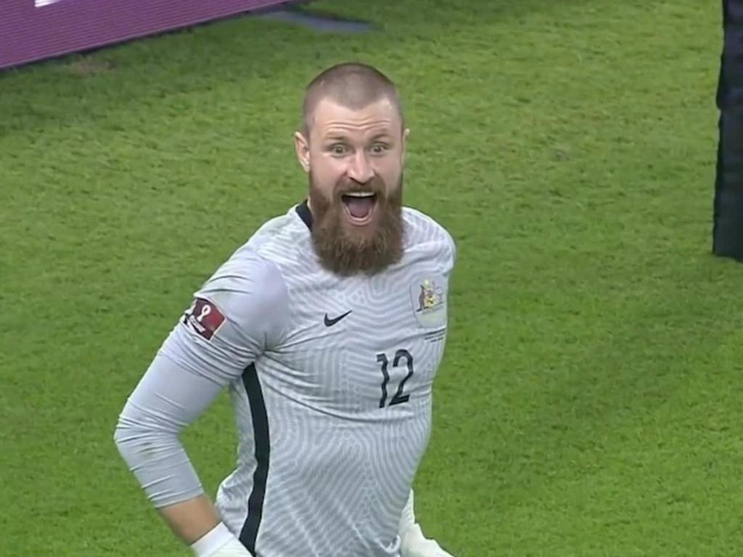
But...
The culprit of my failure
Andrew Redmayne

Slide 6
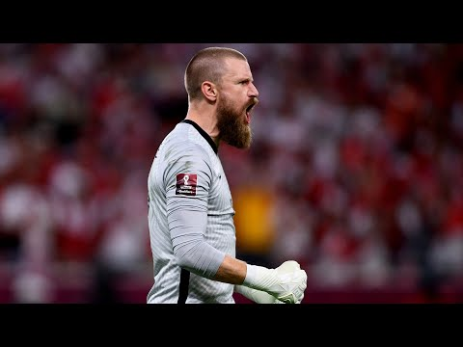
Football is the most difficult sport to predict.
Several parameters can change the course of a match
Andrew Redmayne's dance and penalty save

Slide 7

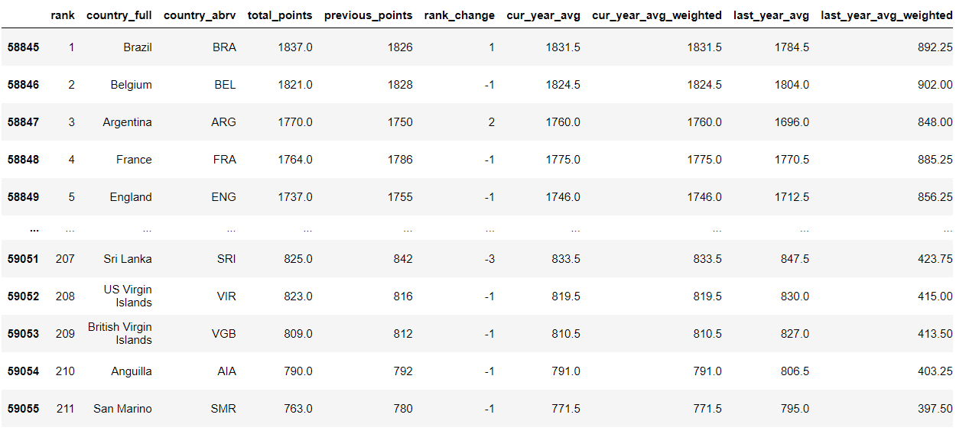
Source Data.
CSV Files
3 Sources from Kaggle
- Results from 1872 to 2022.
- FIFA Ranking from 1993 to 2022.
- A Dataset from the participants of the World Cup.

Slide 8

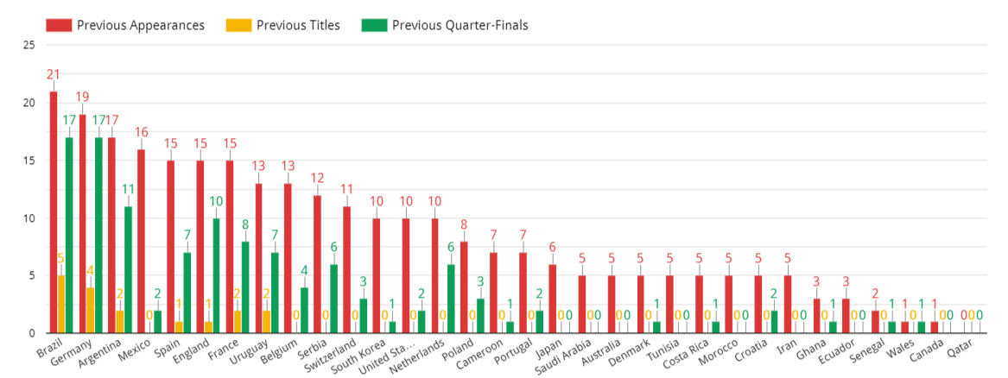
Data Exploration.
Data Studio is my friend
Graphs vizualisations with help of my data

Slide 9

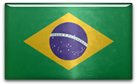












Teams To Follow.
Favorites, Contenders & Outsiders
Favorites: France Brazil Argentina England
Contenders: Netherlands Spain Belgium Germany Portugal
Outsiders: Senegal Denmark Croatia Uruguay Japan

Slide 10
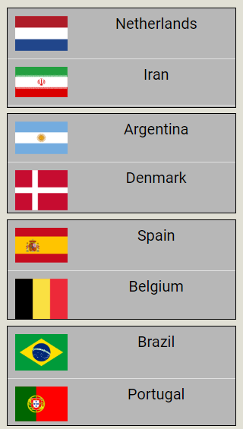
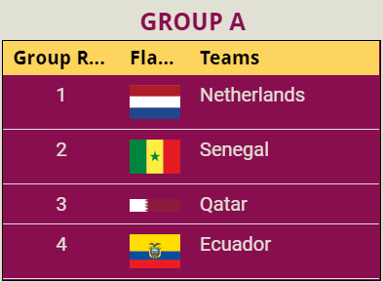
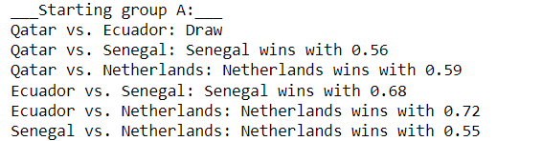
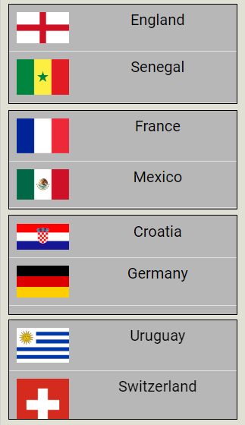
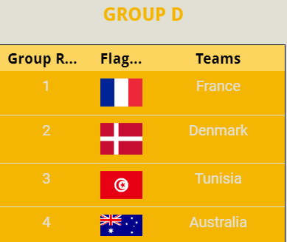
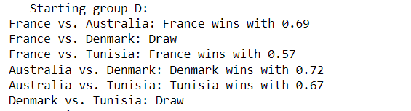
Results.
And the winner is...
Here are some examples of results of group A and D and also of Round 16

Slide 11
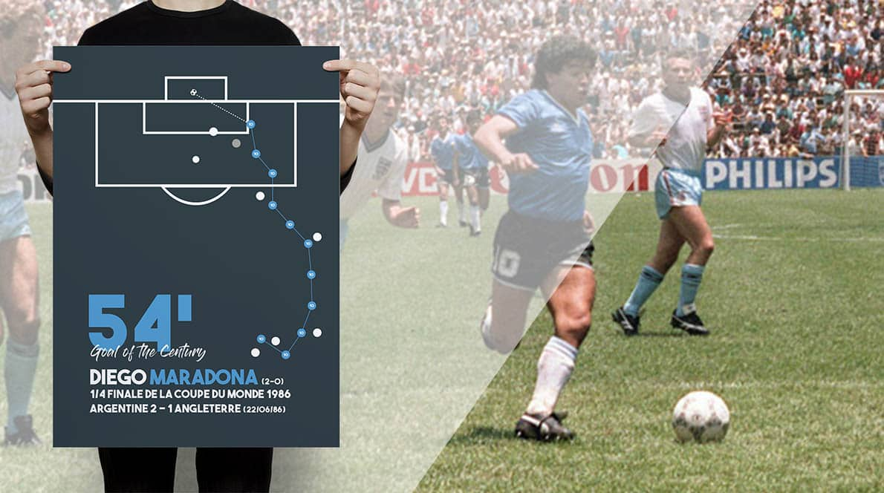
Conclusion.
Comparison of the state of play with Maradona's goal of the century in 1986.
O

Slide 12
Thank you.
12

